Slide 1

Computational Structures in Data Science
UC Berkeley EECS Lecturer Michael Ball
Lecture 6: Recursion (cont)
October 14, 2019
http:cs88.org

Slide 2

Computational Concepts Toolbox
Data type: values, literals, operations,
e.g., int, float, string
Expressions, Call expression
Variables
Assignment Statement
Sequences: tuple, list
indexing
Data structures
Tuple assignment
Call Expressions
Function Definition Statement
Conditional Statement
Iteration:
data-driven (list comprehension)
control-driven (for statement)
while statement
Higher Order Functions
Functions as Values
Functions with functions as argument
Assignment of function values
Recursion
Lambda - function valued expressions
Notes:
z = 1,2
x,y = 3,4
a,b = z

Slide 3
Today’s Lecture
Recursion
More practice
Some tips & tricks
Abstract Data Types
More use of functions!
Value in documentation and clarity
Not on next Monday’s midterm

Slide 4
Announcements
MIDTERM MOVED!
Monday 10/21 7-9pm
No Assignments Due this week
Saturday October 19th 5 - 8:30 pm

Slide 5
Recall: Iteration
1. Initialize the “base” case of no iterations
2. Starting value
def sum_of_squares(n):
accum = 0
for i in range(1,n+1):
accum = accum + i*i
return accum
3. Ending value
4. New loop variable value

Slide 6
Recursion Key concepts – by example
1. Test for simple “base” case
2. Solution in simple “base” case
def sum_of_squares(n):
if n < 1:
return 0
else:
return sum_of_squares(n-1) + n**2
3. Assume recusive solution to simpler problem
4. Transform soln of simpler problem into full soln

Slide 7
Recursion
Base Case:
What stops the recursion?
Recursive Case:
Divide
Invoke
Combine2
def sum_of_squares(n):
if n < 1:
return 0
else:
return sum_of_squares(n-1) + n**2

Slide 8
Why does it work
sum_of_squares(3)
# sum_of_squares(3) => sum_of_squares(2) + 3**2
# => sum_of_squares(1) + 2**2 + 3**2
# => sum_of_squares(0) + 1**2 + 2**2 + 3**2
# => 0 + 1**2 + 2**2 + 3**2 = 14

Slide 9
How does it work?
Each recursive call gets its own local variables
Just like any other function call
Computes its result (possibly using additional calls)
Just like any other function call
Returns its result and returns control to its caller
Just like any other function call
The function that is called happens to be itself
Called on a simpler problem
Eventually bottoms out on the simple base case
Reason about correctness “by induction”
Solve a base case
Assuming a solution to a smaller problem, extend it

Slide 10
Questions
In what order do we sum the squares ?
How does this compare to iterative approach ?
def sum_of_squares(n):
accum = 0
for i in range(1,n+1):
accum = accum + i*i
return accum
def sum_of_squares(n):
if n < 1:
return 0
else:
return sum_of_squares(n-1) + n**2
def sum_of_squares(n):
if n < 1:
return 0
else:
return n**2 + sum_of_squares(n-1)

Slide 11
Local variables
def sum_of_squares(n):
n_squared = n**2
if n < 1:
return 0
else:
return n_squared + sum_of_squares(n-1)
Each call has its own “frame” of local variables
What about globals?
https://goo.gl/CiFaUJ

Slide 12
Fibonacci Sequence
F₀ = 0
F₁ = 1
F_{n} = F_{n-1} + F_{n-2} 0, 1, 1, 2, 3, 5, 8, 13, 21, 34, 55, 89, ….

Slide 13
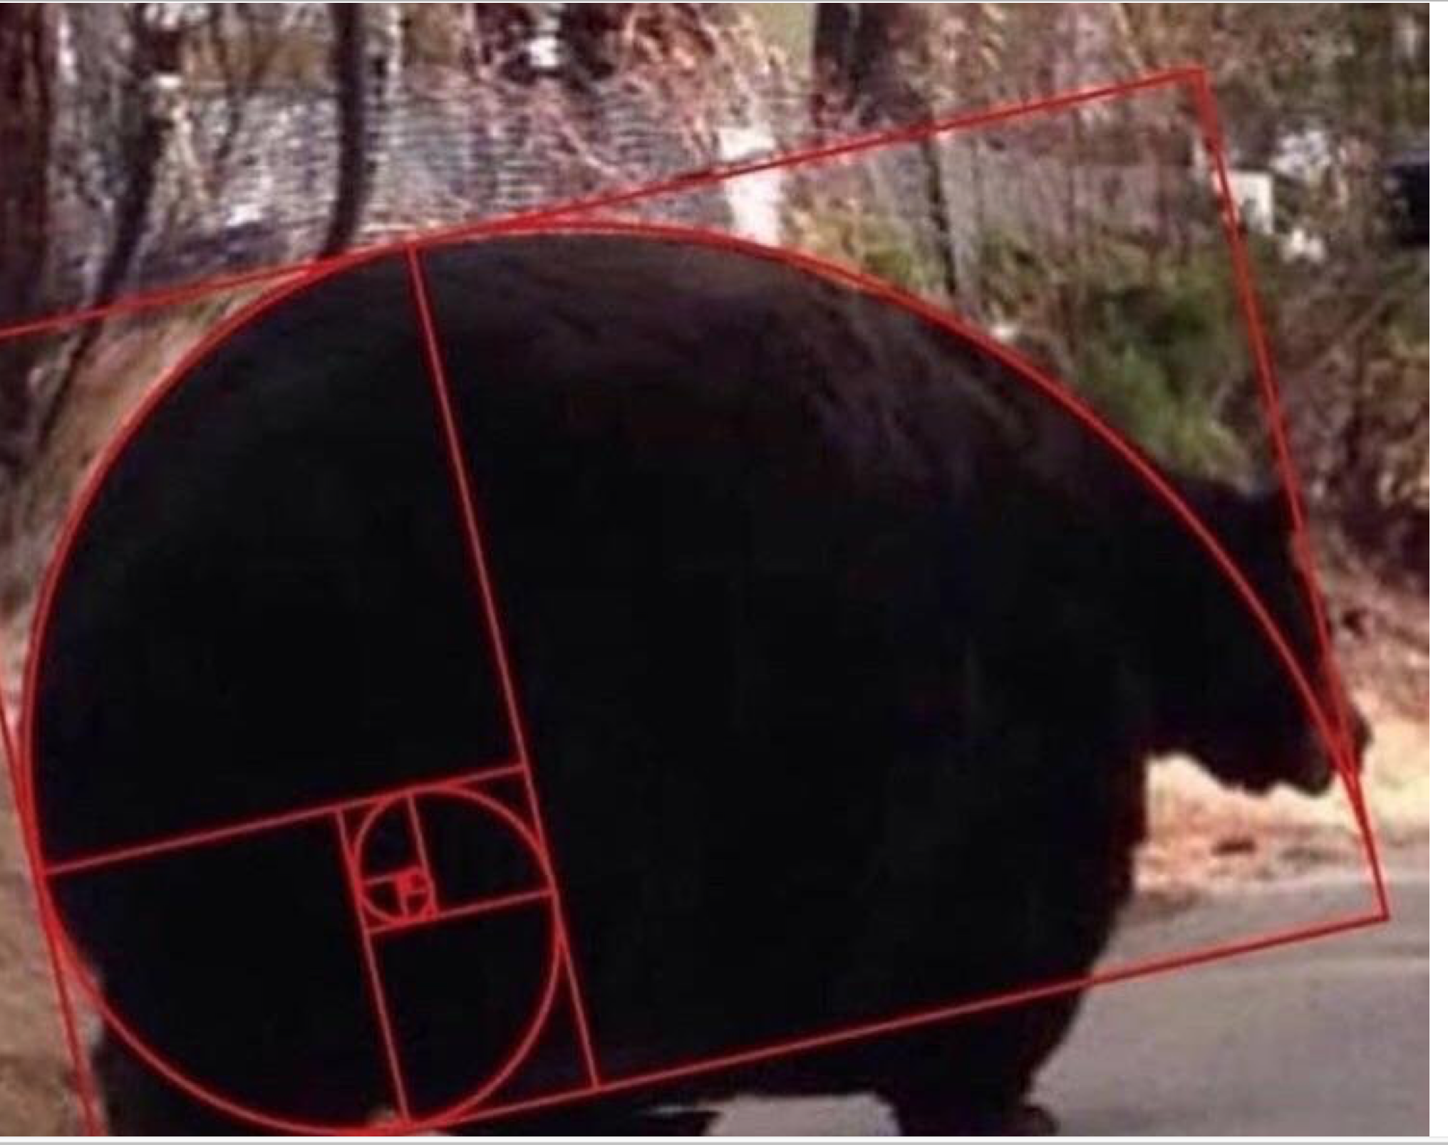
Go Bears!

Slide 14
How many calls?
How many calls of fib() does executing fib(4) make? E.g. Calling fib(1) makes 1 call.
A) 4
B) 5
C) 8
D) 9
E) 16

Slide 15
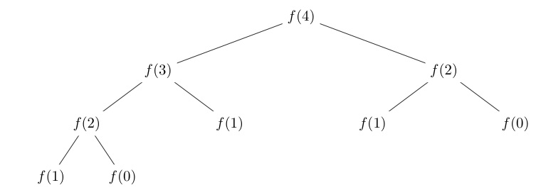
Answer 9
Fib(4) → Fib(3), Fib(2)
Fib(3) → Fib(2), Fib(1)
Fib(2) → Fib(1), Fib(0)

Slide 16
Trust …
The recursive “leap of faith” works as long as we hit the base case eventually
What happens if we don’t?

Slide 17

Recursion (unwanted)

Slide 18
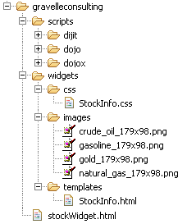
Example I
List all items on your hard disk
Files
Folders contain
Files
Folders
Recursion!

Slide 19
Extra: List Files in Python
def listfiles(directory):
content = [os.path.join(directory, x) for x in os.listdir(directory)]
dirs = sorted([x for x in content if os.path.isdir(x)])
files = sorted([x for x in content if os.path.isfile(x)])
for d in dirs:
print d
listfiles(d)
for f in files:
print f
Iterative version about twice as much code and much harder to think about.

Slide 20
Abstract Data Type
Operations
Object
Constructors
A new Data Type
Selectors
Internal Representation
Operations
Implementation on that
Internal representation
External Representation
Interface
Abstraction Barrier!

Slide 21
Why ADTs?
“Self-Documenting”
contact_name(contact)
Vs contact[0]
“0” may seem clear now, but what about in a week? 3 months?
Change your implementation
Maybe today it’s just a Python List
Tomorrow: It could be a file on your computer; a database in web

Slide 22
Examples Data Types You have seen
Lists
Constructors:
list( … )
[ <exps>,… ]
[<exp> for <var> in <list> [ if <exp> ] ]
Selectors: <list> [ <index or slice> ]
Operations: in, not in, +, *, len, min, max
Mutable ones too (but not yet)
Tuples
Constructors:
tuple( … )
( <exps>,… )
Selectors: <tuple> [ <index or slice> ]
Operations: in, not in, +, *, len, min, max

Slide 23
An Abstract Data Type: Key-Value Pair
Collection of key-Value bindings
Key : Value
Many real-world examples
Dictionary, Directory, Phone book, Course Schedule, Facebook Friends, Movie listings, …
Given some Key, What is the value associated with it?

Slide 24
Key-Value ADT
Constructors
kv_empty: create an empty KV
kv_add: add a key:value binding to a KV
kv_create: create a KV from a list of key,value tuples
Selectors
kv_items: list of (key,value) tuple in KV
kv_keys: list of keys in KV
kv_values: list of values in KV
Operations
kv_len: number of bindings
kv_in: presence of a binding with a key
kv_display: external representation of KV

Slide 25
A little application
phone_book_data = [
("Christine Strauch", "510-842-9235"),
("Frances Catal Buloan", "932-567-3241"),
("Jack Chow", "617-547-0923"),
("Joy De Rosario", "310-912-6483"),
("Casey Casem", "415-432-9292"),
("Lydia Lu", "707-341-1254")
]
phone_book = pb_create(phone_book_data)
print("Jack Chows's Number: ", pb_get(phone_book, "Jack Chow"))
print("Area codes")
area_codes = list(map(lambda x:x[0:3], pb_numbers(phone_book)))
print(area_codes)

Slide 26
A Layered Design Process
Build the application based entirely on the ADT interface
Operations, Constructors and Selectors
Build the operations in ADT on Constructors and Selectors
Not the implementation representation
Build the constructors and selectors on some concrete representation

Slide 27
Example 1
KV represented as list of (key, value) pairs

Slide 28

Dictionaries
Lists, Tuples, Strings, Range
Dictionaries
Constructors:
dict( <list of 2-tuples> )
dict( <key>=<val>, ...) # like kwargs
{ <key exp>:<val exp>, … }
{ <key>:<val> for <iteration expression> }
Selectors: <dict> [ <key> ]
<dict>.keys(), .items(), .values()
<dict>.get(key [, default] )
Operations:
Key in, not in, len, min, max
<dict>[ <key> ] = <val>

Slide 29
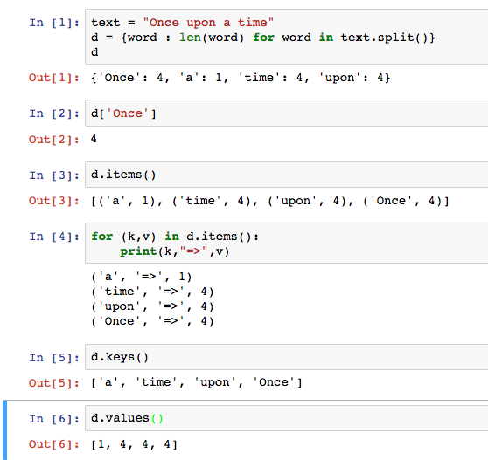
Dictionary Example

Slide 30
Beware
Built-in data type dict relies on mutation
Clobbers the object, rather than “functional” – creating a new one
Throws an errors of key is not present
We will learn about mutation shortly

Slide 31
Example 3
KV represented as dict

Slide 32
C.O.R.E concepts
Perform useful computations treating objects abstractly as whole values and operating on them.
Compute
Operations
Provide operations on the abstract components that allow ease of use – independent of concrete representation.
Abstract Data Type
Representation
Constructors and selectors that provide an abstract interface to a concrete representation
Evaluation
Execution on a computing machine
Abstraction Barrier

Slide 33
Creating an Abtract Data Type
Constructors & Selectors
Operations
Express the behavior of objects, invariants, etc
Implemented (abstractly) in terms of Constructors and Selectors for the object
Representation
Implement the structure of the object
An abstraction barrier violation occurs when a part of the program that can use the higher level functions uses lower level ones instead
At either layer of abstraction
Abstraction barriers make programs easier to get right, maintain, and modify
Few changes when representation changes

Slide 34
Building Apps over KV ADT
friend_data = [
("Christine Strauch", "Jack Chow"),
("Christine Strauch", "Lydia Lu"),
("Jack Chow", "Christine Strauch"),
("Casey Casem", "Christine Strauch"),
("Casey Casem", "Jack Chow"),
("Casey Casem", "Frances Catal Buloan"),
("Casey Casem", "Joy De Rosario"),
("Casey Casem", "Casey Casem"),
("Frances Catal Buloan", "Jack Chow"),
("Jack Chow", "Frances Catal Buloan"),
("Joy De Rosario", "Lydia Lu"),
("Joy De Lydia", "Jack Chow")
]
Construct a table of the friend list for each person

Slide 35
Example: make_friends
def make_friends(friendships):
friends = kv_empty()
for (der, dee) in friendships:
if not kv_in(friends, der):
friends = kv_add(friends, der, [dee])
else:
der_friends = kv_get(friends, der)
friends = kv_add(kv_delete(friends, der),
der, [dee] + der_friends)
return friends

